Slide 1
Unit 1-Problem solving agents and problem formulation

Slide 2

Problem solving agents
Is a Goal based agent
Defines or formulates a problem
Goal formulation done before problem formulation
Define the elements that constitute a problem and its solution
Several general-purpose search algorithms used for solving problems are considered
Search algorithms are mainly of two types:
Uninformed search
Only definition of the problem known
No information other than definition is known
Informed search
Not just the definition
Some more information is known

Slide 3
Goal formulation is very important for problem formulation
Goal formulation is done first before problem formulation
Goal formulation: decide on which aspects of the environment must be considered and what must be abstracted away or ignored.
So that in problem formulation we have to manipulate only the relevant information
Problem formulation if done without goal formulation we will be unaware on what information to include and what not to
Several iterative cycles between the goal formulation and problem formulation might be there before the problem-solving agent can arrive at an efficient solution

Slide 4
Why a Goal based agent?
The objective here is to use an intelligent agent to solve the problem
We give a domain description of the problem to the agent and the agent will have to solve it,like a black box.
Intelligent agent sometimes maximizes the performance when the goal is provided to it.
Here the AI researchers are trying to find a single algorithm(Search algorithm) for solving all AI problems.
This requires all problems to have a common input representation.
Along with the common input representation the goal formulation must also be there.
Goal formulation is in fact the first step of problem formulation
Done using the notion of “States”

Slide 5

States
States gives all the information related to the environment
All the information necessary to make a decision for the task at hand is included
Different views of representing a state
Atomic view
Prepositional or factored view
Relational view
Object view or first order view

Slide 6


Atomic view:
States indivisible
No internal structure
1,2,3,4,5,6,7,8
Prepositional view:
States divisible to variables
Value of variables can be compared
Robo in left room(T/F)
Dirt in left(T/F)
Dirt in right(T/F)
State1:[T T T]
State 2: [F T T]
Change in environment analyzed by the change in variable values

Slide 7

Relational view:
world is made up of objects
Objects and their relations decide the state
In(<Robo>,<Room>)
Dirty(<Room>)
Object or first order view:
Objects and some function on them
In(<Robo>,<Room>
Dirty(<Room>)
Suck()
Move()

Slide 8


Well defined problem and solution
Well defined problem constitutes of 4 components
Initial state
Set of states or possible actions
Goal test
Path cost
1)Initial State:
Starting state
Travelling from
Arad to Bucharest
Start state is Arad

Slide 9

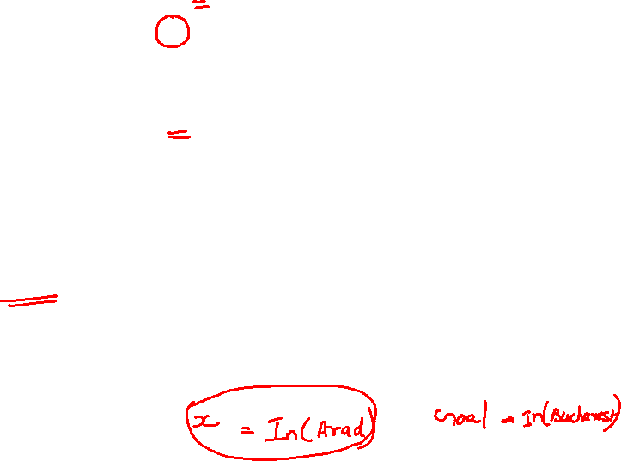
2)Set of states
Uses a successor Function
Given a particular State x
SUCCESSOR_FN(x) will
Return a set of
<action,successor>
Start state: In(Arad)
SUCCESSOR_FN(In(Arad)
={<Go(Sibiu), In(Sibiu)>
<Go(Timisoara), In(Timisoara)>
<Go(Zerind), In(Zerind)>}

Slide 10
State space of the problem :
Set of initial state and successor functions
Gives the set of all states reachable from the start state
Path:
Sequence of states connected together
3) Goal test
Determines whether the state reached is the Goal state or not
There can be more than one Goal state
Travelling from Arad to Bucharest has a single Goal state(singleton set)
Goal state: {In(Bucharest)}

Slide 11

4) Path Cost
Numeric cost of
the path
Cost from
Arad to Zerind =75
Solution: a path from the initial state to the Goal state
Optimal solution: cheapest path or Shortest path
If cost of path not important then the shortest path is considered

Slide 12


Example problems
8 puzzle problem
Start state? 7,2,4,5,B,6,8,3,1
Goal state? B,1,2,3,4,5,6,7,8
Set of states? 9 factorial
Move blank left
Move blank right
Move blank top
Move blank bottom
Path cost? Each step costs 1
so No. of states
Uninformed search :
Problem definition known(start and goal known)
No other information

Slide 13
7 | 2 | 4
5 |  | 6
8 | 3 | 1
7 |  | 4
5 | 2 | 6
8 | 3 | 1
7 | 2 | 4
5 | 3 | 6
8 |  | 1
7 | 2 | 4
 | 5 | 6
8 | 3 | 1
7 | 2 | 4
5 | 6
8 | 3 | 1
7 | 2 | 4
5 |  | 6
8 | 3 | 1
 | 7 | 4
5 | 2 | 6
8 | 3 | 1
7 | 4
5 | 2 | 6
8 | 3 | 1

Slide 14
Example problems
Vacuum Cleaner

Slide 15
• Initial state: Any state can be designated as the initial state.
Set of States: The state is determined by both the agent location and the dirt locations.
The agent is in one of two locations, each of which might or might not contain dirt.
• Actions: Three actions: Left, Right, and Suck.
• Goal test: This checks whether all the squares are clean.
• Path cost: Each step costs 1, so the path cost is the number of steps in the path.

Slide 16
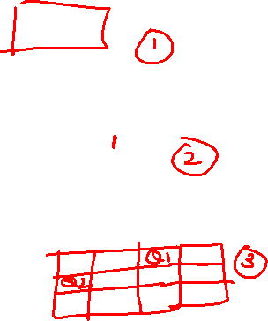
N Queens problem
Initial state: Empty board
Set of States: place queens one by one on the board
• Goal test: All queens placed, none attacking.
• Path cost: not interested in path cost. All queens must be placed without conflicting.
 |  | Q
Q
 |  |  | Q
 | Q

Slide 17
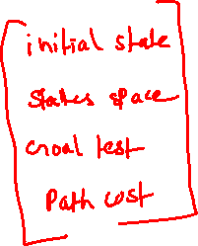
Real world problems
Route finding problem
Travelling salesman problem
VLSI layout
Robot Navigation
Automatic assembly sequencing

